Slide 1


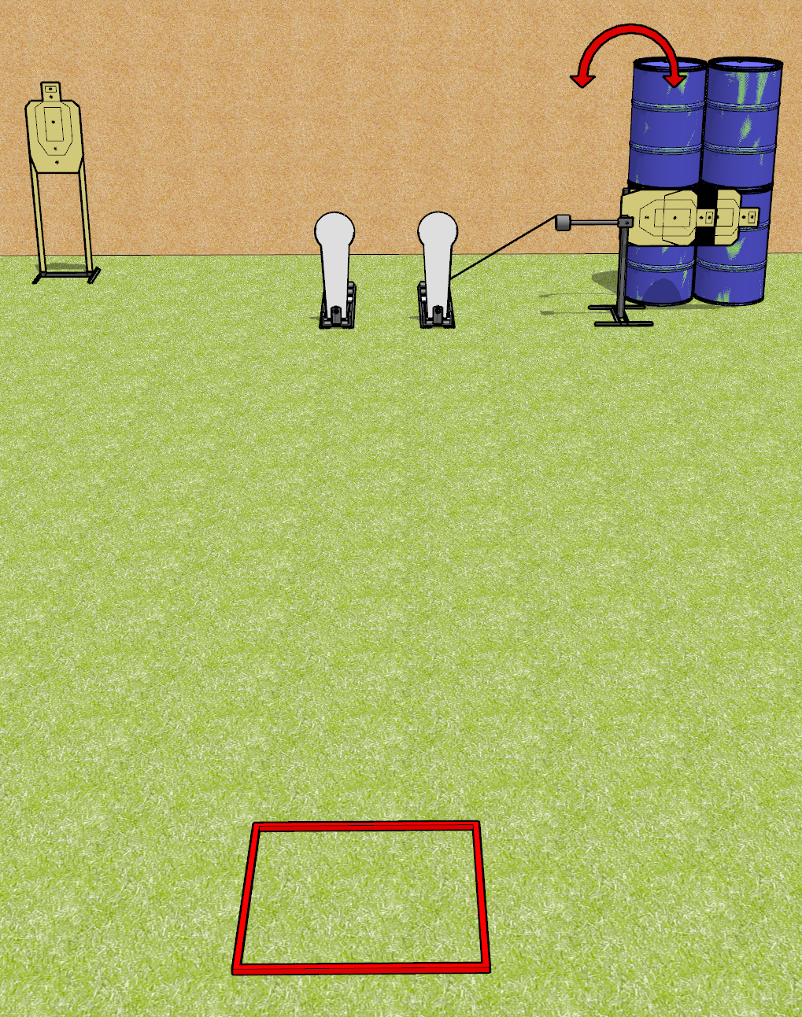
 | Dothan Gun Club – USPSA Match Speedy Meanie Course Designer : Drew Coleman
Round Count 8 rounds 3 USPSA targets 2 colt poppers
Equipment List Swinger 2 USPSA targets cut in half with non-scoring border

Slide 2
Speedy Meanie
Written Stage Briefing
Speedy Meanie is an 8 round, 40 point, Comstock speed shoot. There are 3 USPSA targets and 2 colt poppers. The best 2 hits on paper will score, and steel must fall to score. The start signal is audible.
The swinger is activated by the right colt popper, and remains visible at rest.
Handgun start position is in shooting box with wrists above respective shoulders. Handgun is loaded and holstered.
PCC start position is in shooting box with stock on belt. Loaded carbine is held with both hands, safety on.
On start signal, engage targets as they become available from within the shooting area.

Slide 3
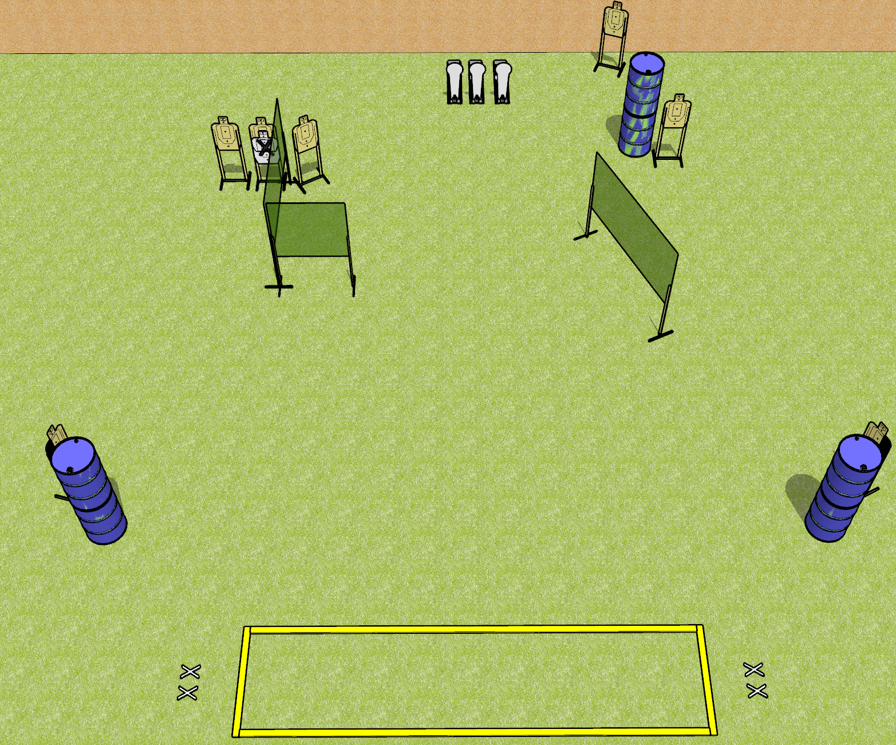
 | Dothan Gun Club – USPSA Match Hot Step Course Designer : Drew Coleman
Round Count 17 rounds 7 USPSA 3 colt poppers
Equipment List 2 medium fault lines, 4x10’ fault lines 5 wall feet 1 left and 1 right hard cover

Slide 4
Hot Step
Written Stage Briefing
Hot Step is a 17 round, 85 point, Comstock course of fire. There are 7 USPSA targets and 3 colt poppers. The best 2 hits on paper will score, and steel must fall to score. The start signal is audible.
Handgun start position is feet on either set of X’s, wrists below belt. Handgun is loaded and holstered.
PCC start position is feet on either set of X’s, stock on belt. Loaded carbine is held with both hands, safety on.
On start signal, engage targets as they become available from within the shooting area.

Slide 5
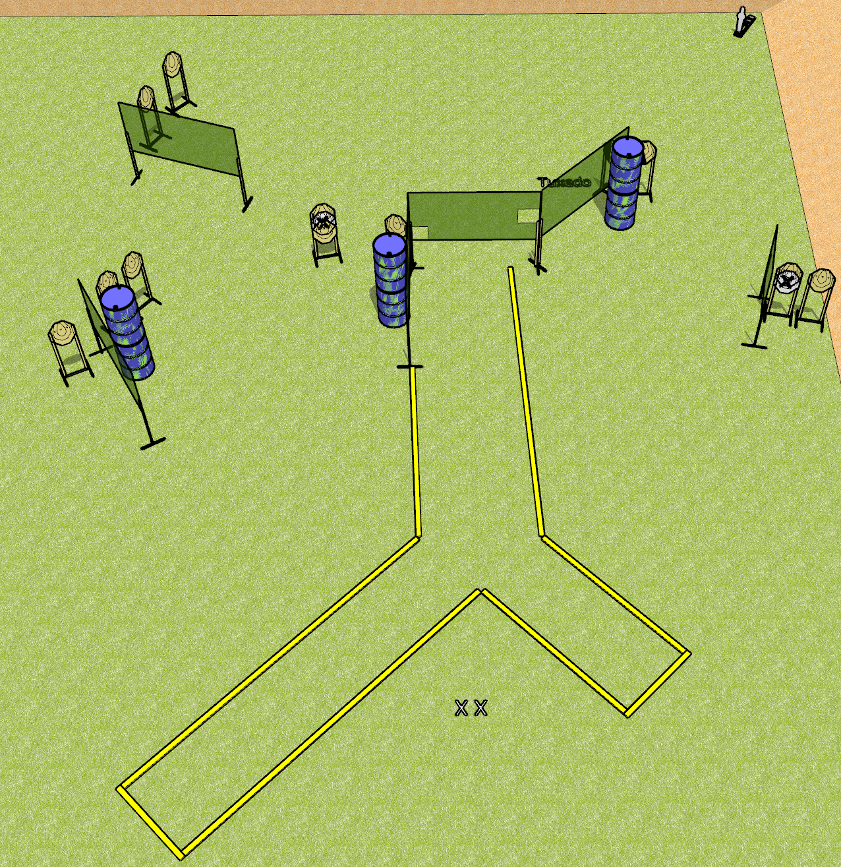
 | Dothan Gun Club – USPSA Match Angles Course Designer : Drew Coleman
Round Count 25 rounds 12 IPSC 1 mini popper
Equipment List 2 medium fault lines 11 wall feet 1 tux, 1 left diagonal

Slide 6
Angles
Written Stage Briefing
Angles is a 25 round, 125 point, Comstock course of fire. There are 12 IPSC targets and 1 mini popper. The best 2 hits on paper will score, and steel must fall to score. The start signal is audible.
Handgun start position is both feet on X’s, wrists below belt. Handgun is loaded and holstered.
PCC start position is both feet on X’s, stock on belt. Loaded carbine is held with both hands, safety on.
On start signal, engage targets as they become available from within the shooting area.

Slide 7
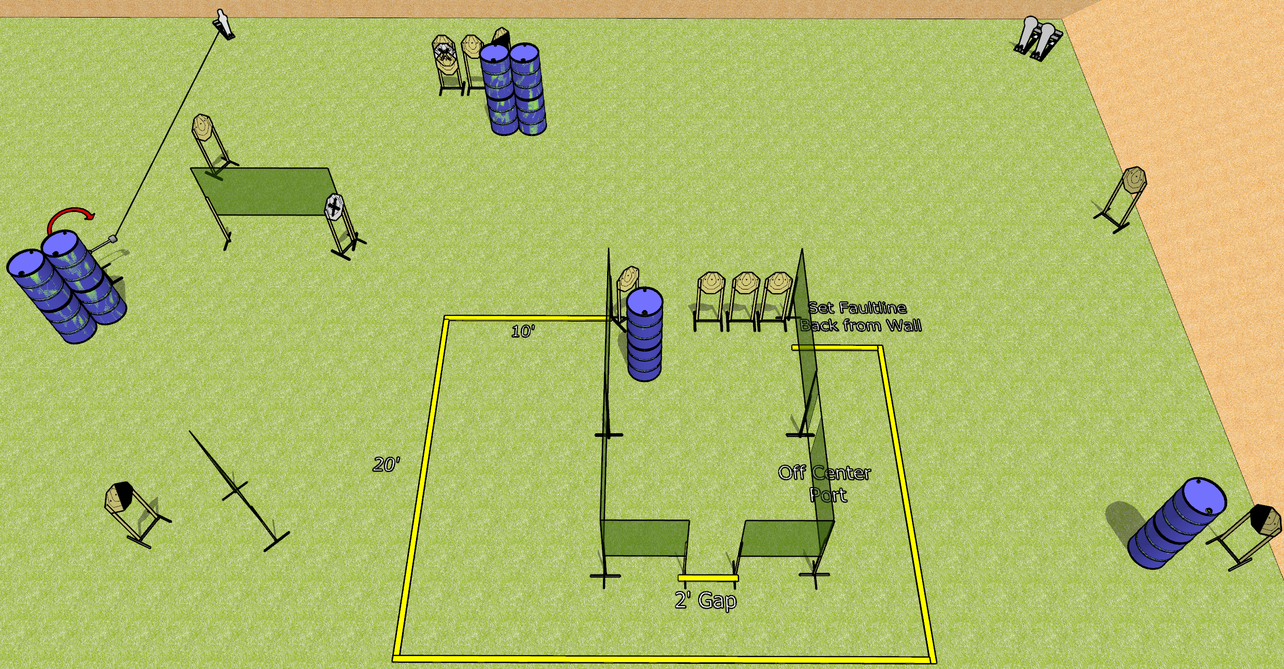
 | Dothan Gun Club – USPSA Match Glitch in the Turtle Course Designer : Drew Coleman
Round Count 29 rounds 13 IPSC 2 colt poppers, 1 mini popper
Equipment List 1 medium fault line, 1 small fault line 12 wall feet 1 swinger + activator 1 left and 1 right diagonal, 1 50%
15’

Slide 8
Glitch in the Turtle
Written Stage Briefing
Glitch in the Turtle is a 29 round, 145 point, Comstock course of fire. There are 13 IPSC targets, 2 colt poppers, and 1 mini popper. The best 2 hits on paper will score, and steel must fall to score. The start signal is audible.
The swinger is activated by the mini popper and remains visible at rest.
Handgun start position is inside the shooting area, wrists below belt. Handgun is loaded and holstered.
PCC start position is inside the shooting area, stock on belt. Loaded carbine is held with both hands, safety on.
On start signal, engage targets as they become available from within the shooting area.

Slide 9
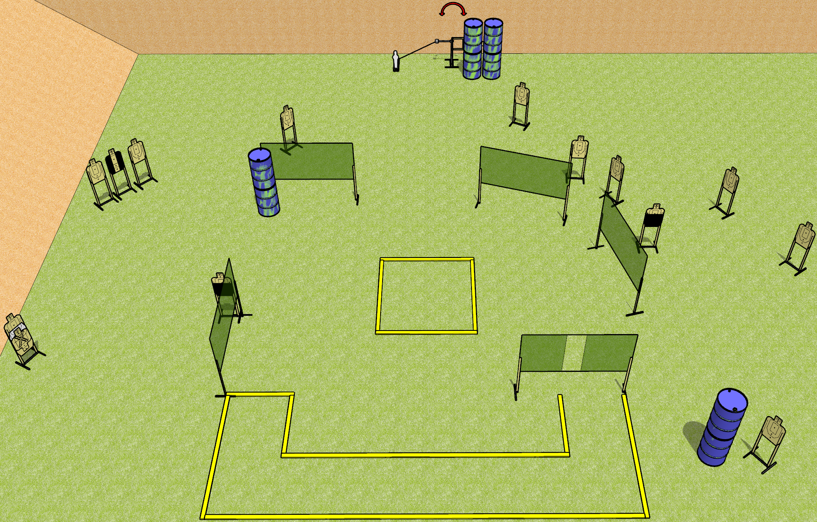
 | Dothan Gun Club – USPSA Match Smile! Course Designer : Drew Coleman
Round Count 31 rounds 15 USPSA 1 mini popper
Equipment List 3 medium fault lines 10 wall feet 2 50%, 1 tux 1 Swinger + activator
A
6’
B

Slide 10
Smile!
Written Stage Briefing
Smile! is a 31 round, 155 point, Comstock course of fire. There are 15 USPSA targets and 1 mini popper. The best 2 hits on paper will score, and steel must fall to score. The start signal is audible.
The swinger is activated by the mini popper, and remains visible at rest.
Handgun start position is inside shooting area A, wrists below belt. Handgun is loaded and holstered.
PCC start position is inside shooting area A, stock on belt. Loaded carbine is held with both hands, safety on.
On start signal, engage targets as they become available from within the shooting areas.

